Slide 1
CS4254
Computer Network Architecture and Programming
Dr. Ayman A. Abdel-Hamid
Computer Science Department
Virginia Tech
OSI and TCP/IP Layers

Slide 2
Outline
  OSI Layering Architecture
  TCP/IP Layers

Slide 3
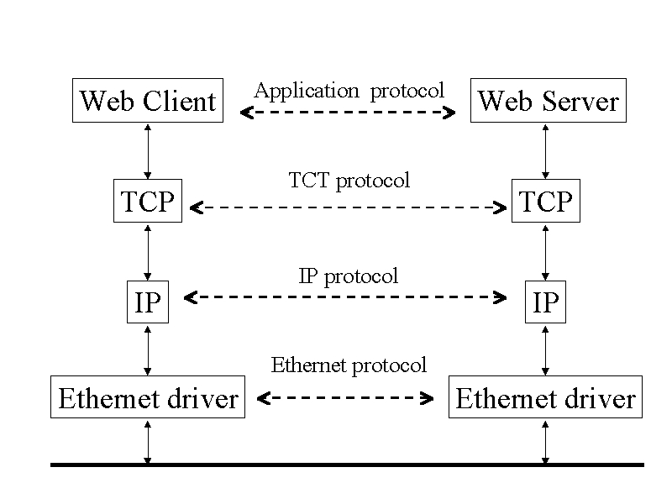
Multiple Layers of Network Protocols
Client and Server on same Ethernet
User process
Protocol stack within kernel
Ethernet

Slide 4
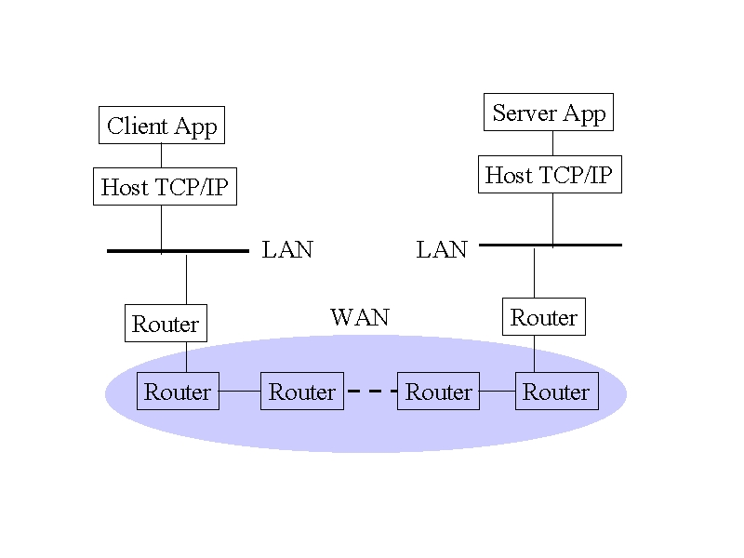
Multiple Layers of Network Protocols
Client and server on different LANs connected through a WAN
Differentiate
  Hub
  L2 switch
  L3 switch
  Router

Slide 5
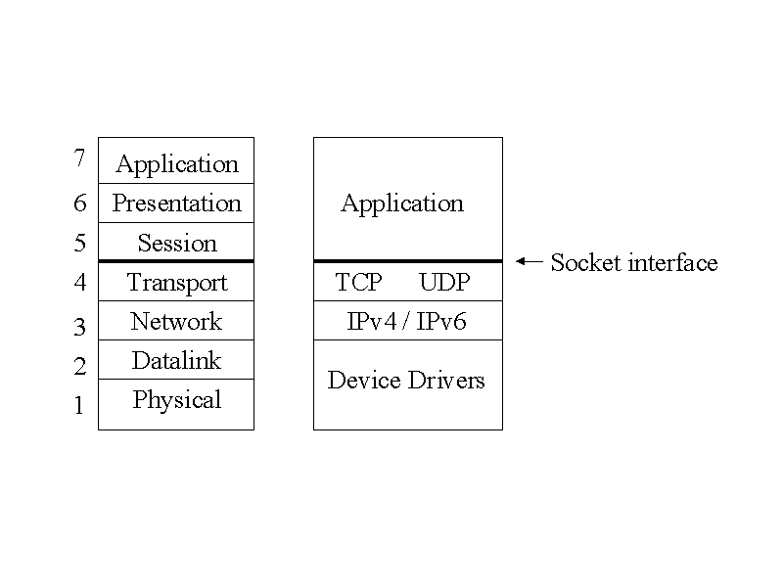
Layers in OSI Model and Internet Protocol Suite
OSI: Open Systems Interconnection model for computer communications
ISO: International Organization for Standardization
User process, application details
kernel, communication details

Slide 6
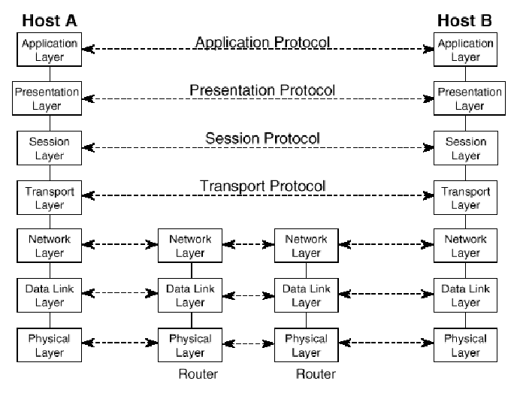
OSI Layers

Slide 7
Physical Layer 1/2
Functions
  Transmission of a raw bit stream
  Forms the physical interface between devices
Issues
  Which modulation technique (bits to pulse (analog signal))?
  Which Line Coding technique (bits to digital signal?)
  How long will a bit last? (bit interval vs bit rate)
  Bit- serial or parallel transmission?
  Half- or Full- duplex transmission?
  How many pins does the network connector have?
  How is a connection set up or torn down?

Slide 8
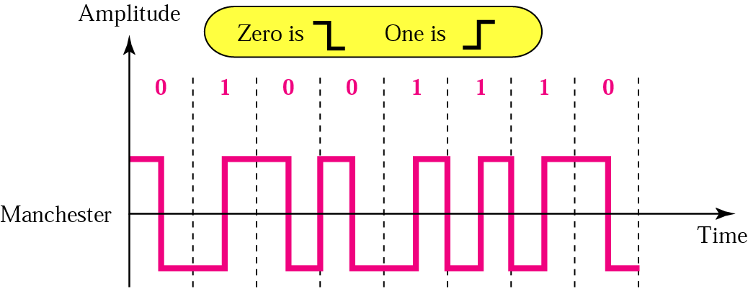
Physical Layer 2/2
Line Coding Example: Manchester Encoding

Slide 9
Data Link Layer 1/2
Functions
  Provides reliable transfer of information between two adjacent nodes (physical link is a raw transmission facility)
  Creates frames (manageable data units) from bits and vice versa
  Physical addressing (identify frame sender and/or receiver)
  Provides frame- level error control (normally through a trailer added at end of frame)
  Provides flow control
  Access Control (through a MAC sub layer)
In summary, the data link layer provides the network layer with what appears to be an error- free link for packets

Slide 10
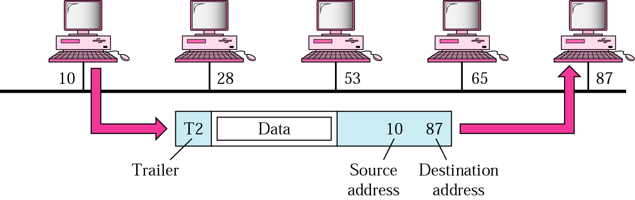
Data Link Layer 2/2

Slide 11
Network Layer 1/2
Functions
  Source-to-destination delivery of packets across multiple networks
  Logical addressing
  Responsible for routing decisions
    Dynamic routing
    Fixed routing
Performs congestion control
  In the Internet model, the network layer does not perform congestion control
  Congestion control at the network layer is a current area of research

Slide 12
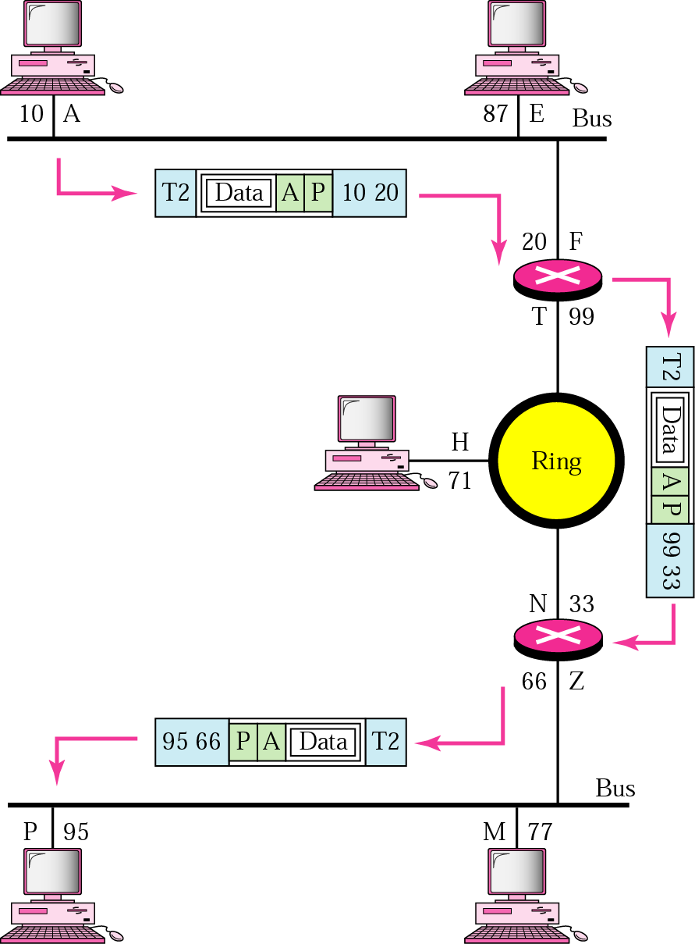
Network Layer 2/2

Slide 13
Transport Layer
Functions
  Process-to-process delivery of entire message
  Port addressing
  Connection control
  Provides reliable end-to-end communication
  Perform end-to-end flow control
  Perform packet retransmission when packets are lost by the network
  In the Internet model, the transport layer also offers congestion control.

Slide 14
Session Layer
Functions
  Network dialog controller
    Establish, maintain, and synchronize interaction between communicating entities
  May perform synchronization between several communicating applications
  Groups several user- level connections into a single “session”

Slide 15
Presentation Layer
Functions
  Concerned with syntax and semantics of information exchanged between 2 systems
  Performs specific functions that are requested regularly by applications
    Encryption
    Compression
    Translation
      ASCII to Unicode, Unicode to ASCII
      LSB- first representations to MSB- first representations

Slide 16
Application Layer
Functions
  Application layer protocols are application-dependent
  Implements communication between two applications of the same type
  Examples
    FTP
    HTTP
    SMTP (email)

Slide 17
OSI Layering Problems
Seven layers not widely accepted
Standardized before implemented
Top three layers fuzzy
Internet or TCP/ IP layering widespread

Slide 18
Internet Design Principles
Scale
  Protocols should work in networks of all sizes and distances
Incremental deployment
  New protocols need to be deployed gradually
Heterogeneity
  Different technologies, autonomous organizations
End-to-end argument [End-to-end Arguments in System Design]
  Networking functions should be delegated to the edges; application knows best
  “A function can only be completely and correctly implemented with the knowledge and help of the applications standing at the communication end points”

